Slide 1
ML Project (ECG analysis)
Made by: Sangerbaev Maxat (16BD02024) and Markitanov Denis (16BD02042)

Slide 2
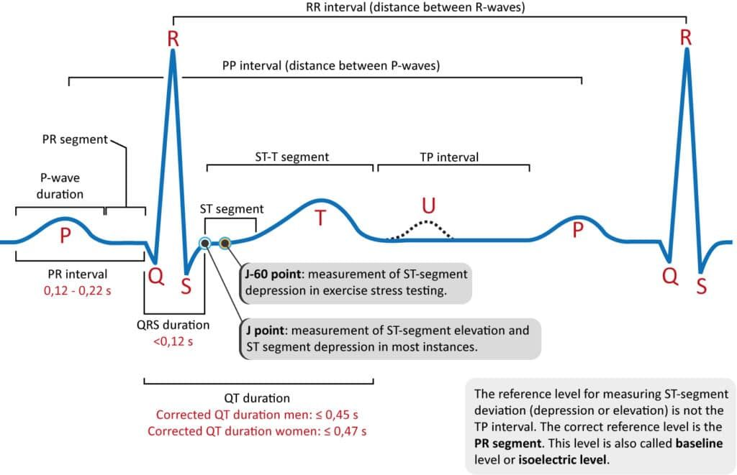
ECG and intervals
RR interval (600 – 1200 ms)
PR interval (120 – 200 ms)
QRS interval (80 – 100 ms)

Slide 3
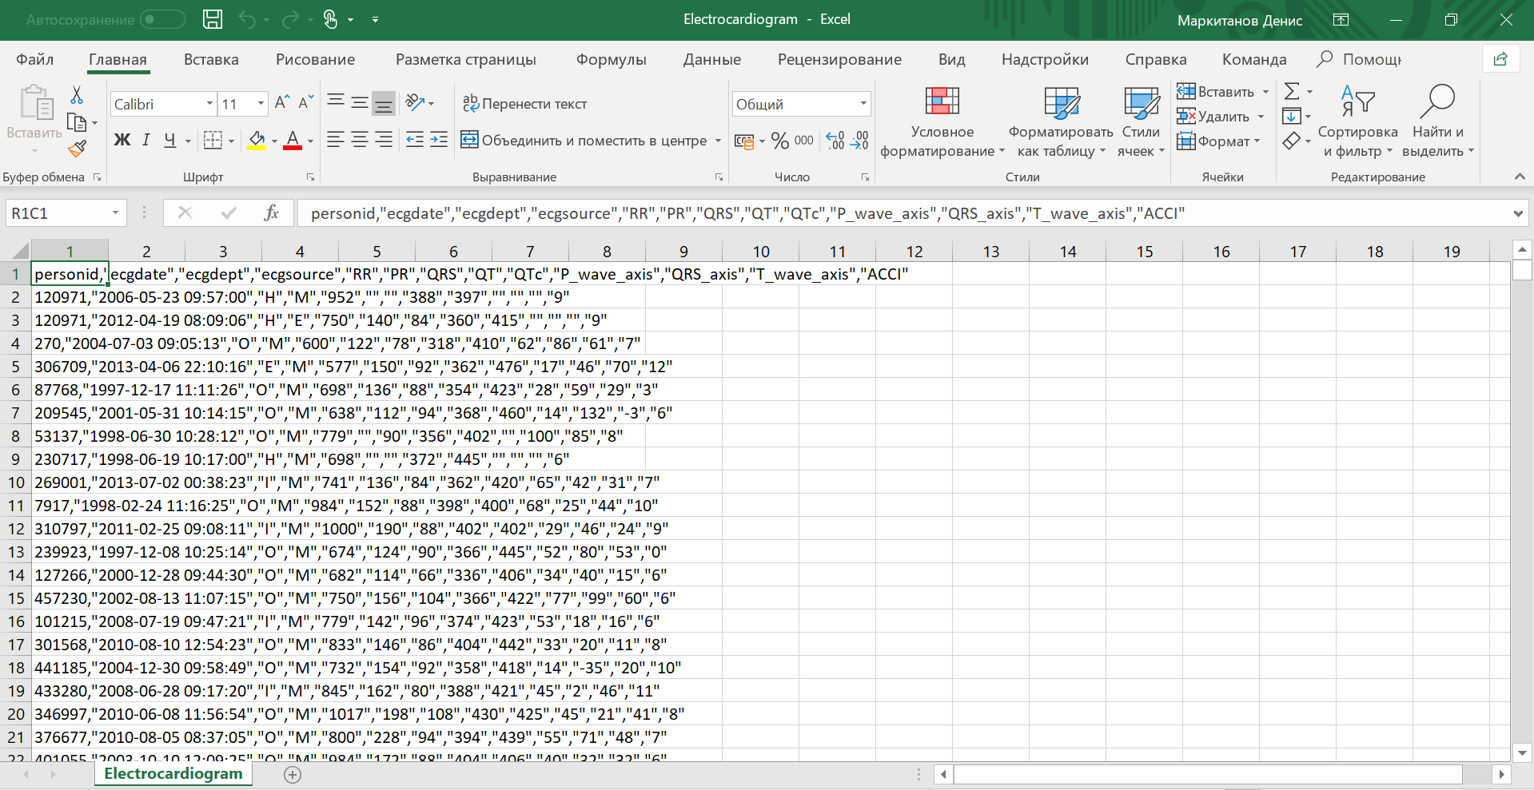
Data Set

Slide 4
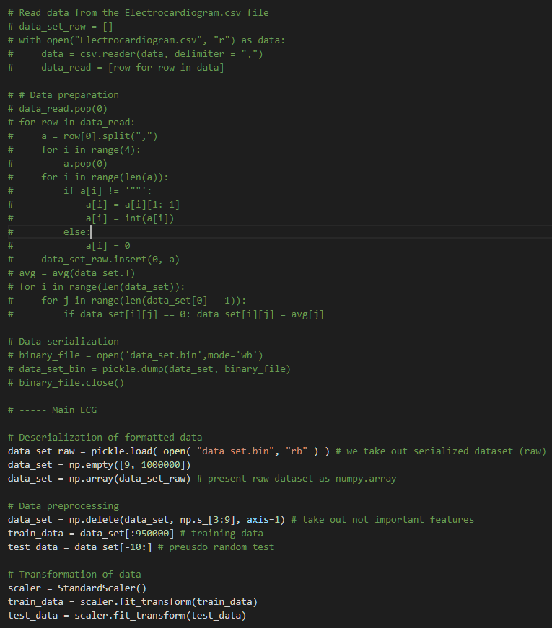
Data Preparation

Slide 5
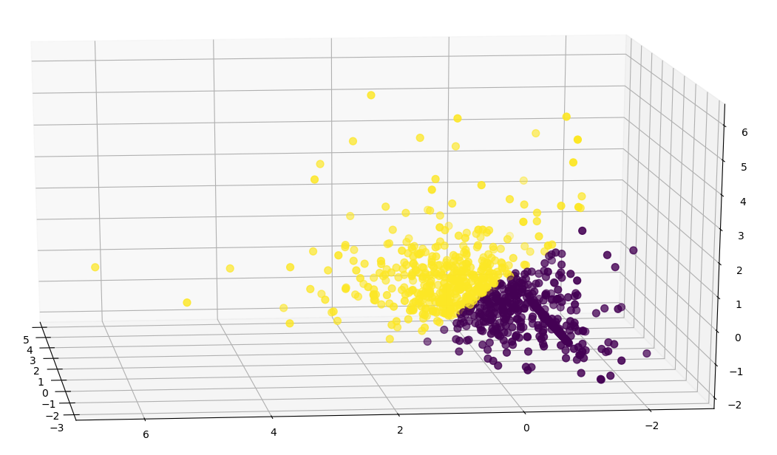
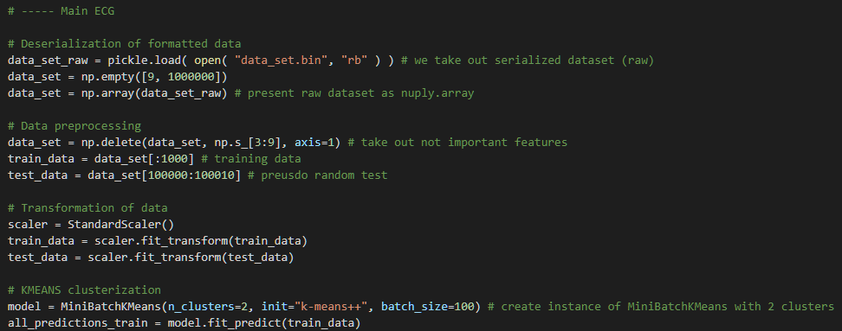
Correct clusterization
(This may not be the final realization)

Slide 6
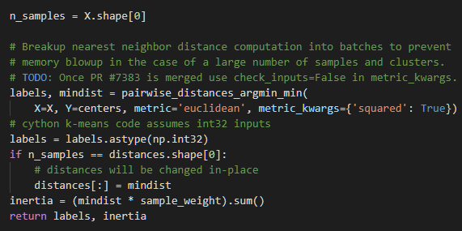
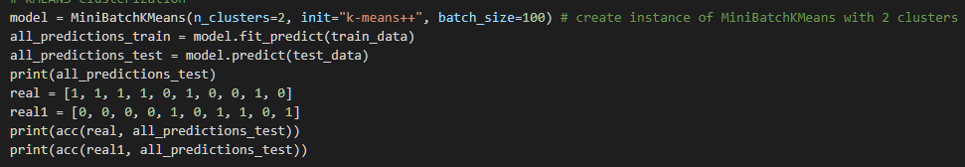
Classification: MiniBatchKMeans (sklearn)

Slide 7
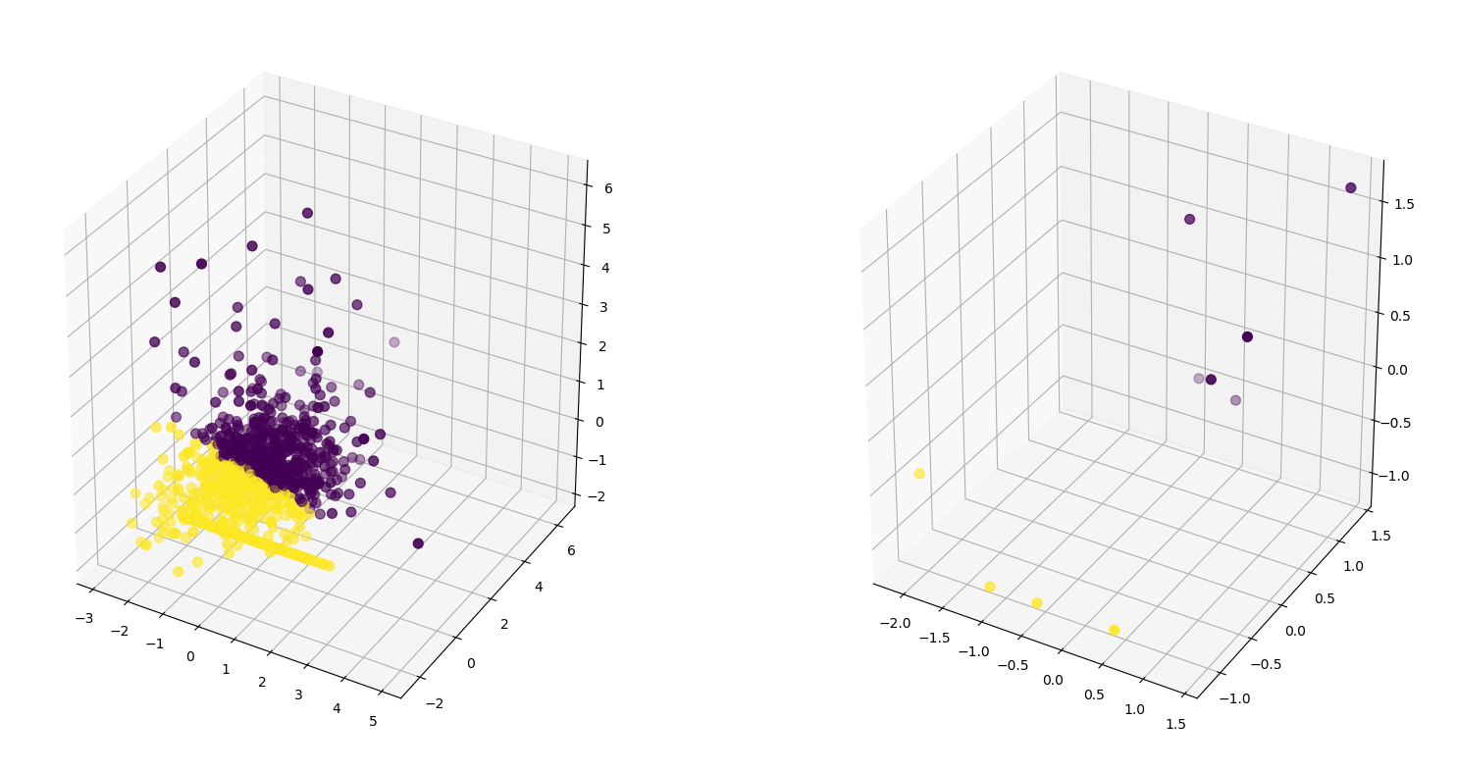
Result

Slide 8
Main Problem:
Data set…

Slide 9
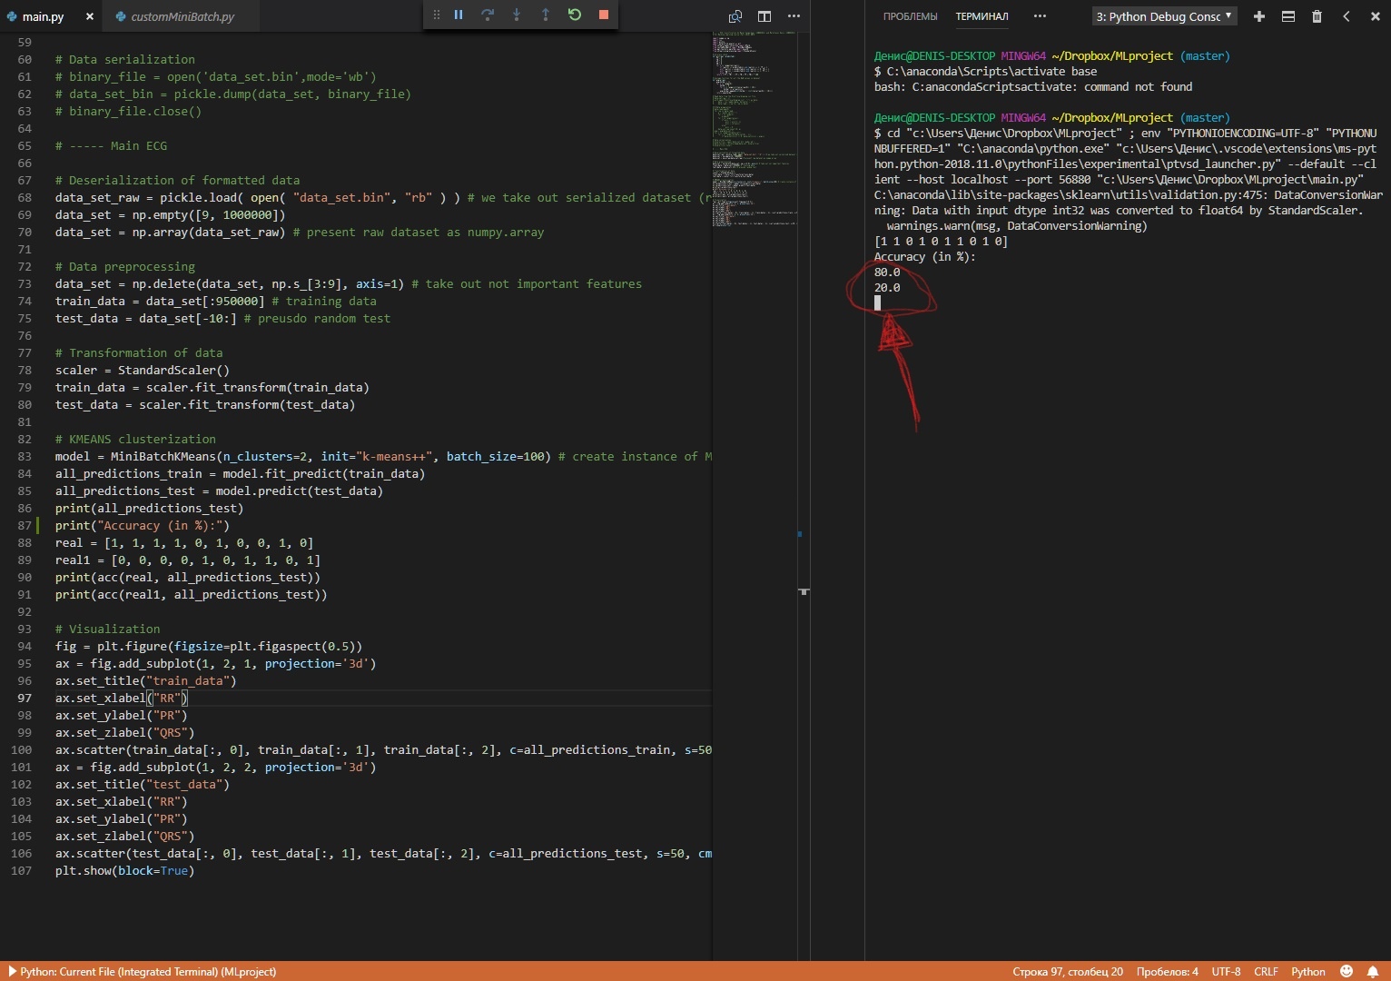
Accuracy is 80%

